Slide 1
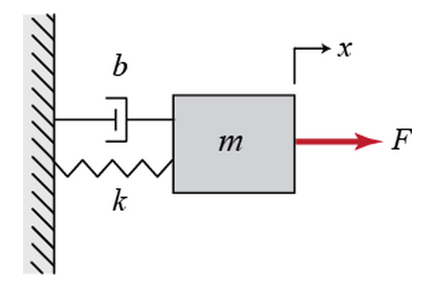
Control System
Simulation
Of
Mass Spring Damper System
Presented By –
Jasjit Singh

Slide 2
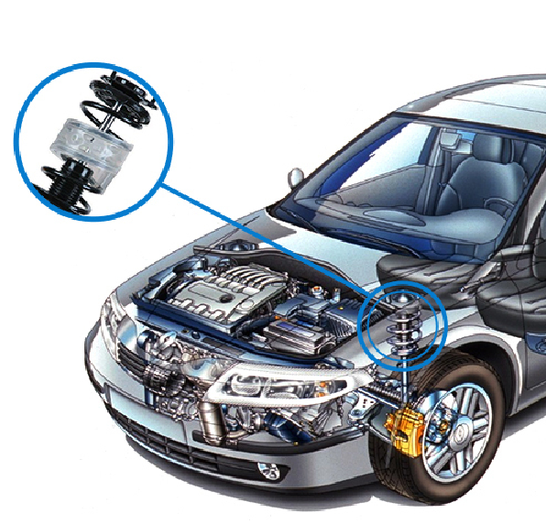
INTRODUCTION TO CONTROL SYSTEMS: PRACTICAL EXAMPLE
1. LET’S UNDERSTAND THE SYSTEM FIRST
SPRING & DAMPER
NO DAMPER
http://www.maplesoft.com/applications/view.aspx?SID=3926&view=html

Slide 3





INTRODUCTION TO CONTROL SYSTEMS: PRACTICAL EXAMPLE
2. LET’S DEVELOP A MATHEMATICAL MODEL
$M\ddot{x}=F−b\dot{x}−kx$
$Ms^{2}X\left(s\right)=F\left(s\right)−bsX\left(s\right)−kX\left(s\right)$
$$\frac{X(s)}{F(s)}=\frac{1}{Ms^{2}+bs+k}$$
Assume M = 1 Kg, b = 10 Ns/m, k = 20 N/m
$$\frac{X(s)}{F(s)}=\frac{1}{s^{s}+10s+20}$$
$$F(s)$$
TRANSFER FUNCTION
$$X(s)$$
$$INPUT$$
$$OUTPUT$$
TRANSFER FUNCTION
http://ctms.engin.umich.edu/CTMS/index.php?example=Introduction&section=ControlPID

Slide 4
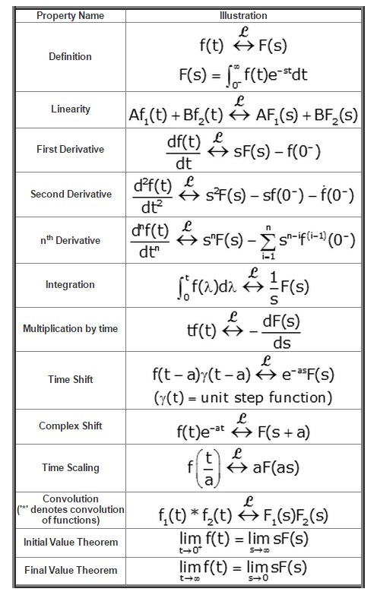

Slide 5
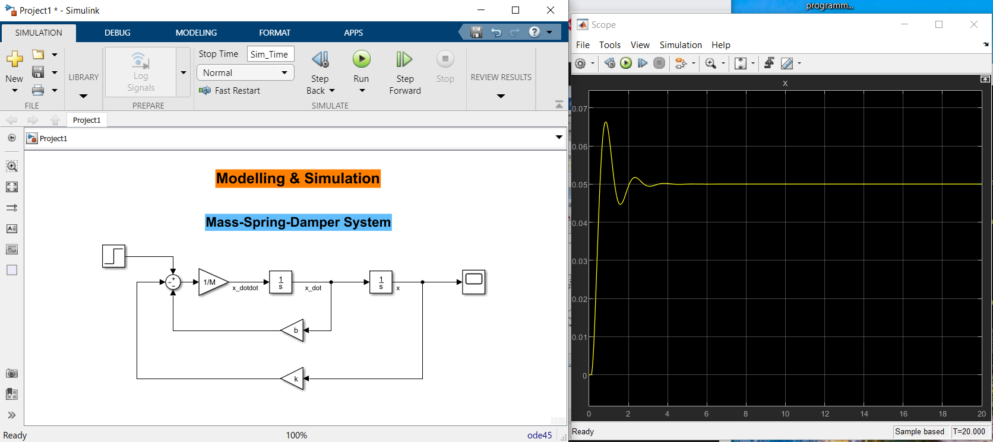
MODELLING & SIMULATION -:

Slide 6
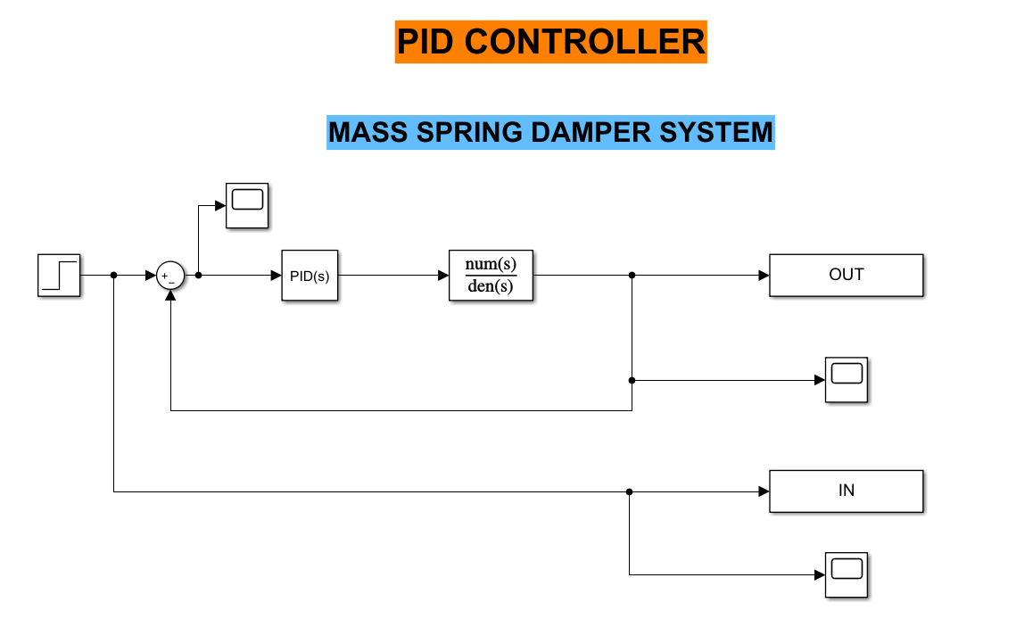
MASS SPRING DAMPER SYSTEM: PID CONTROLLER

Slide 7
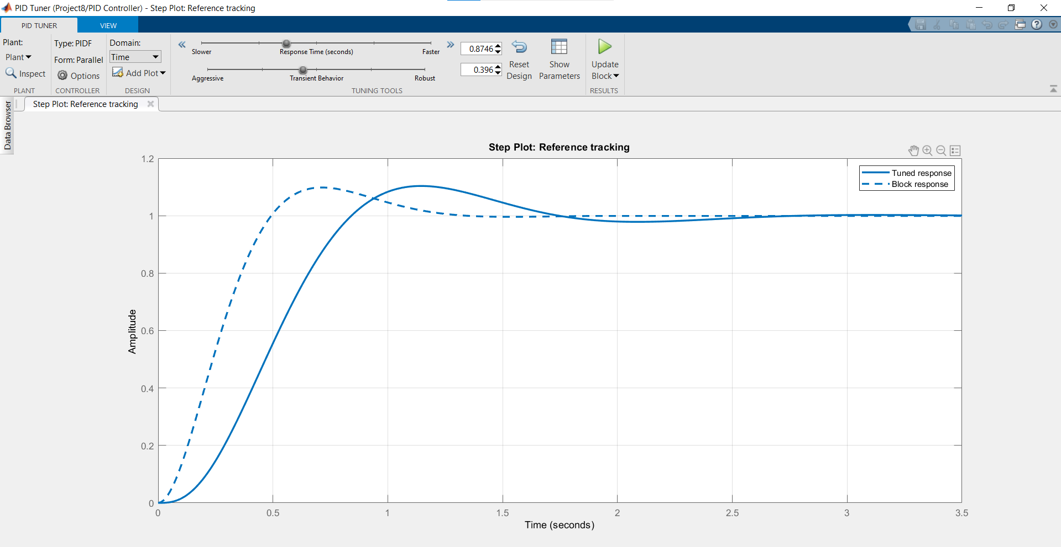
TUNING PID CONTROLLER IN MATLAB

Slide 8

Thank You

